Slide 1
APIs
They’re not just for developers anymore…
vBrown Bag – June 8, 2022

Slide 2



About me
Shannon Kuehn (KEEN)
Identity and Network Access Advocacy Team
Senior Program Manager
@shankuehn
https://www.linkedin.com/in/shannonkuehn/

Slide 3







The Advocacy team is looking for tech influencers.
Live Streamers
Content Creators
Social Media Influencers
Bloggers
Learn More: https://425show.com
Contact: 425show@microsoft.com

Slide 4
Introduction
It’s not AS scary as it might seem…

Slide 5

Wikipedia Definition
“A particular set of rules and specifications that a software program can follow to access and make use of the services and resources provided by another particular software program that implements that API. It serves as an interface between different software programs and facilitates their interaction, similar to the way the user interface facilitates interaction between humans and computers. An API is implemented by applications, libraries, and operating systems to determine their vocabularies and calling conventions, and is used to access their services.”
API - Wikipedia

Slide 6
What is an API?
Acronym
Stands for: Application Programming Interface
But what does that mean?
Letter | Word | Meaning
A | Application | Software that performs a task
P | Programming | Program (P) that performs a task in the Application (A)
I | Interface | Place (I) to tell the program (P) to run

Slide 7





Slide 8
What makes APIs so great?
Easy to read and work with
Useful
Platform independent
Upgrade safe
Simple to handle CRUD operations
Developers don’t need to write the program, just use the API
Now ops folks can do the same thing!

Slide 9
Test your knowledge
Level of Difficulty | Example | I (Interface) | P (Programming) | A (Application)
Simple | Signal text message using cell phone
Simple | Google (or Bing) search using computer
Moderate/Complex | Create orders in eBay when you get them (no browser)
Moderate/Complex | Create orders in SAP when you get them (no browser)

Slide 10
Test your knowledge
Level of Difficulty | Example | I (Interface) | P (Programming) | A (Application)
Simple | Signal text message using cell phone | Cell phone | Messaging | Signal
Simple | Google (or Bing) search using computer | Computer | Search | Google (or Bing)
Moderate/Complex | Create orders in eBay when you get them (no browser) | eBay | Create order | eBay
Moderate/Complex | Create orders in SAP when you get them (no browser) | SAP | Create order | SAP
IMPORTANT: 1) When people talk about APIs, they generally mean Moderate to Complex!
2) Most API discussions involve web APIs.
3) There are 4 different types of APIs:
Public APIs, Partner APIs, Internal APIs, and Composite APIs

Slide 11
API Details
The devil is in the details…

Slide 12


3 things happen
Every transaction or interaction with an API:
Request
Program/task is run
Application sends back a response

Slide 13
The anatomy of an API call
The base URL
The query
The key
http://BASEURL?query=QUERY&api-key=KEY

Slide 14
Demo
APIs ARE easy…promise…

Slide 15
Understanding HTTP
Turns out there’s more happening behind the scenes!

Slide 16
APIs are EVERYWHERE!
APIs over the internet are web services
IMPORTANT: ALL web services are APIs, but NOT ALL APIs are web services
REST is the most common type of API endpoint accessed over the internet
Using HTTP/HTTPS
Hyper Text Transfer Protocol
Hyper Text
Transfer Protocol
Always requestin’ somethin’!

Slide 17
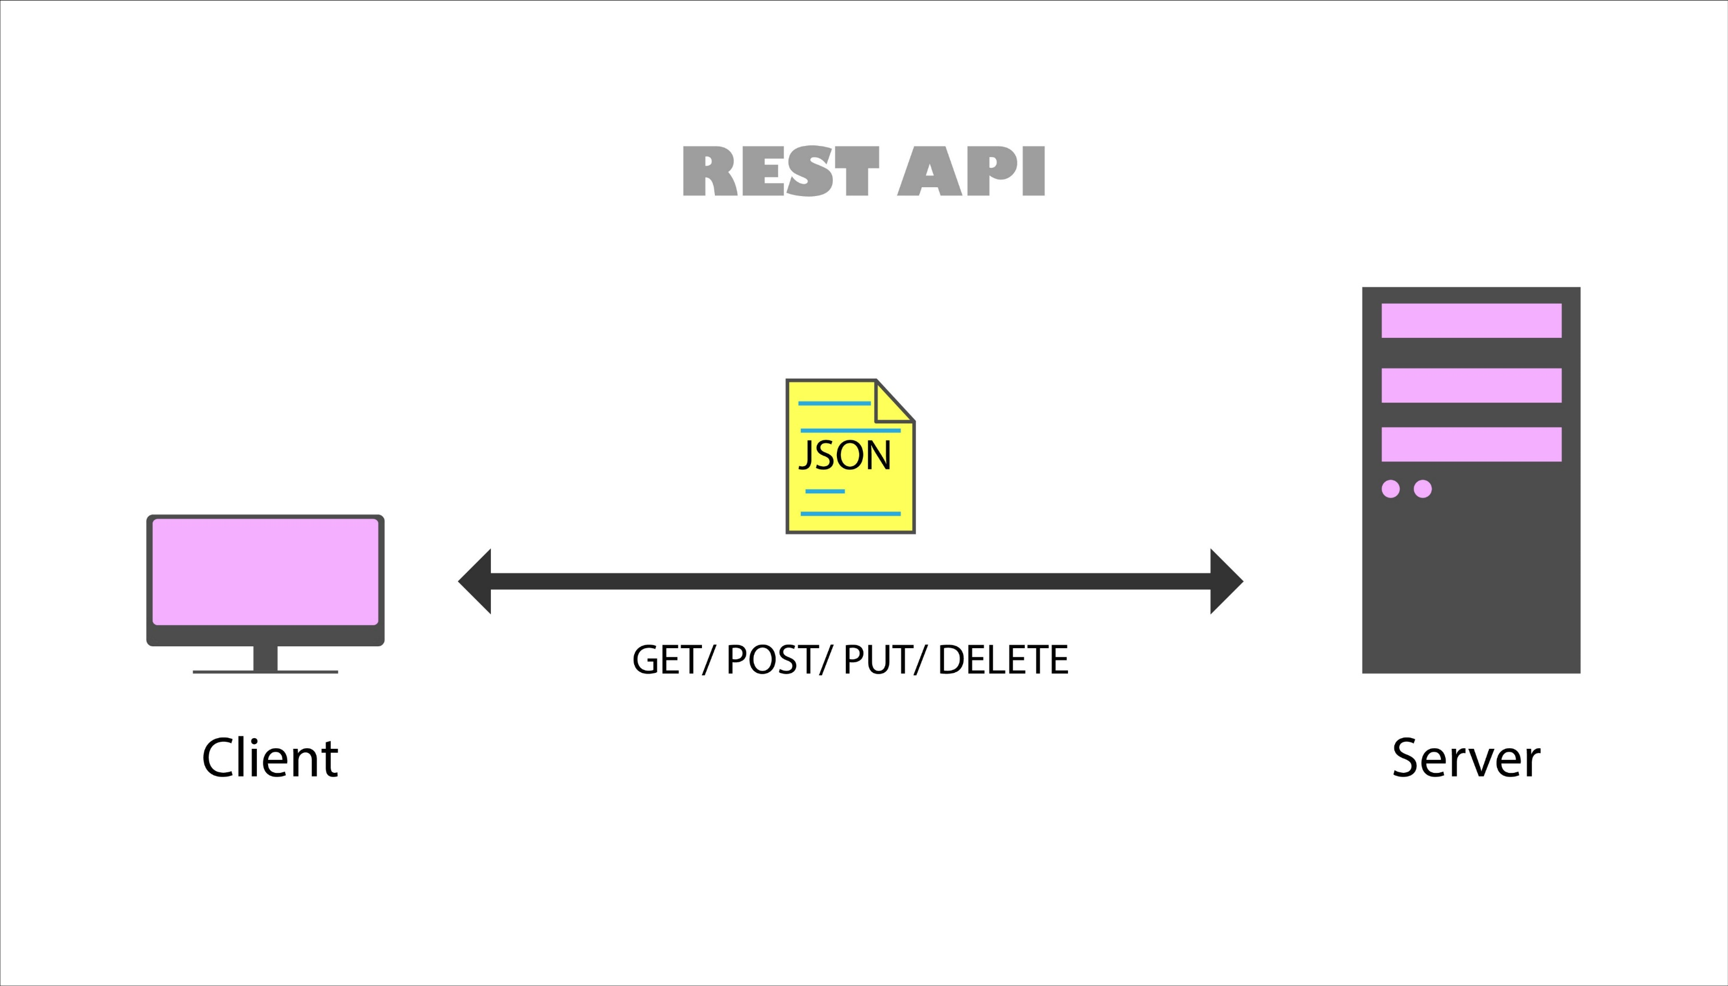

Slide 18
Request HTTP
HTTP | Request | Response
Start line | Version (1.1) Method | Version (1.1) Status code
Headers | Host www.google.com Content-Type Token | Cookie Specify what is being sent back How big is that piece of data?
Blank line | Separates the head from the body | Separates the head from the body
Body | GET POST | Gets data Changes data
Hypertext Transfer Protocol - Wikipedia

Slide 19
Methods
HTTP Method | CRUD Operation | Description
GET | SELECT | Fetches a resource. A resource is never changed via a GET request.
POST | INSERT | Adds to an existing resource
PUT | UPDATE | Updates and replaces existing resource
PATCH | UPDATE | Partial modification or update to a resource
DELETE | DELETE | Deletes a resource

Slide 20
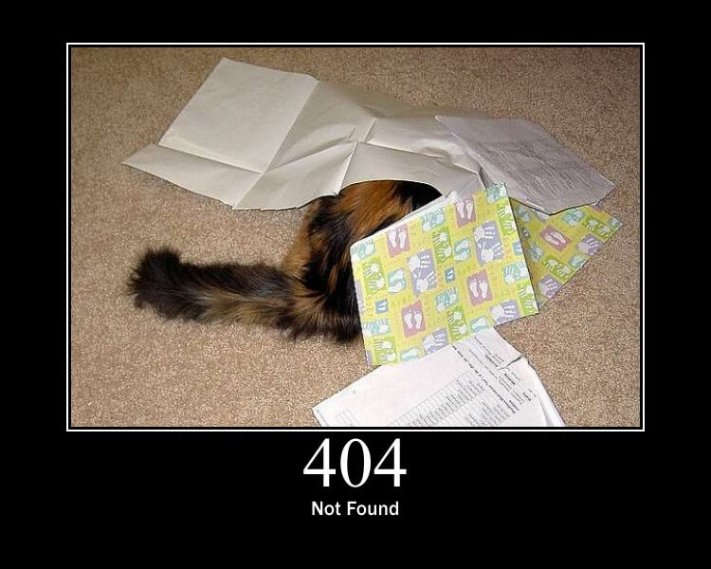
Response Codes
HTTP Response | Meaning
1XX | Informational Codes
2XX | Successful Codes
3XX | Redirection Codes
4XX | Client Error Code
5XX | Server Error Codes
HTTP Status Codes - Wikipedia

Slide 21
Protocols & Architectures
Rules, structures, and constraints that govern a given API’s operation
a.k.a. the boring stuff

Slide 22
SOAP
Simple Object Access Protocol: messaging protocol
Interchanging data in a decentralized/distributed world
Performs well in a distributed enterprise environment.
Doesn’t assume direct point-to-point communication
Works with any application layer protocol (HTTP, SMTP, TCP, UDP)
Returns data to the receiver in XML format
Security, authorization, and error-handling are built into the protocol
Contains the following parts:
Envelope (required)
Header (optional)
Body (required)
Fault (optional)
SOAP - Wikipedia

Slide 23
XML
eXtensible Markup Language
Document format to exchange data (internet/intranet)
Uses tags to label, categorize, and organize information in a specific way
Extensible: most XML applications will work as expected
Even if data is added or removed
Stores in plain text format
Provides a software and hardware independent way of storing, transporting, and sharing data
XML - Wikipedia

Slide 24
XML Basic Example
<note> <date>2022-06-08</date> <hour>19:30</hour> <to>ChrisW</to> <from>ShannonK</from> <body>I have my presentation ready for the vBrown Bag on Wednesday night (6/8/2022)!!</body> </note>

Slide 25
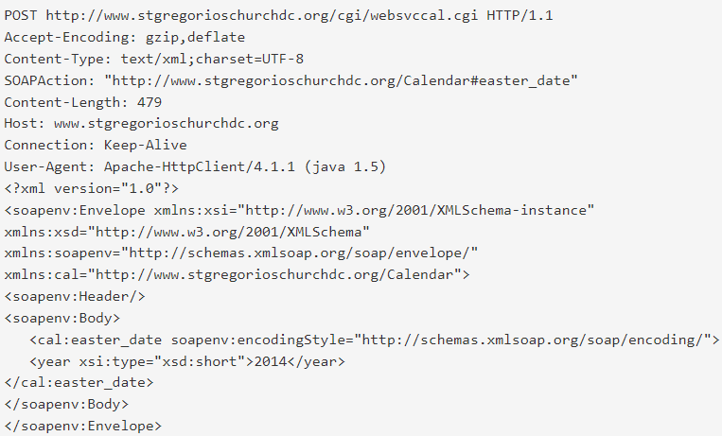
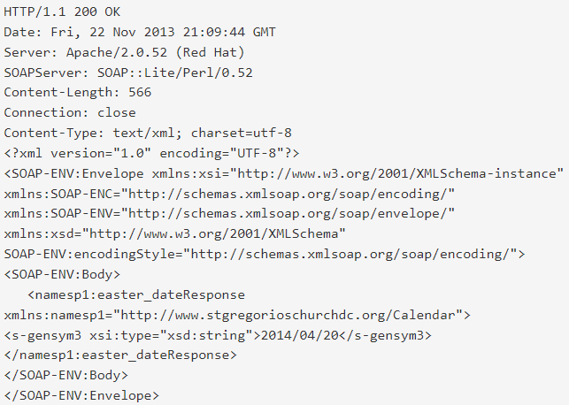
SOAP API example
Request:
Response:
SOAP vs REST APIs: Which Is Right For You? | SoapUI

Slide 26
REST
REpresentational State Transfer
Architectural style that defines a set of recommendations for designing loosely coupled applications that use the HTTP protocol for data transmission
Doesn’t prescribe how to implement the principles at a lower level
REST guidelines allow developers to implement details according to their needs
Need 6 architectural constraints:
Uniform interface
Clint-server separation
Statelessness
Cacheable resources
Layered system
Code on demand (optional)
Representational state transfer - Wikipedia

Slide 27

JSON
JavaScript Object Notation
Lightweight data-interchange format
Easy for:
Humans to read and write
Machines to parse and generate
Text format
Completely language independent
Uses conventions that are familiar to programmers/developers
A collection of name/value pairs
Ordered list of values
JSON - Wikipedia

Slide 28
JSON Basic Example
{
"firstname": "Shannon",
"lastname": "Kuehn",
"city": "Elmwood Park",
"state": "Illinois", "favoritecolors": [
{
"type": "Color1",
"color": "Blue"
},
{ "type": "Color2",
"color": "Black"
}
]
}

Slide 29
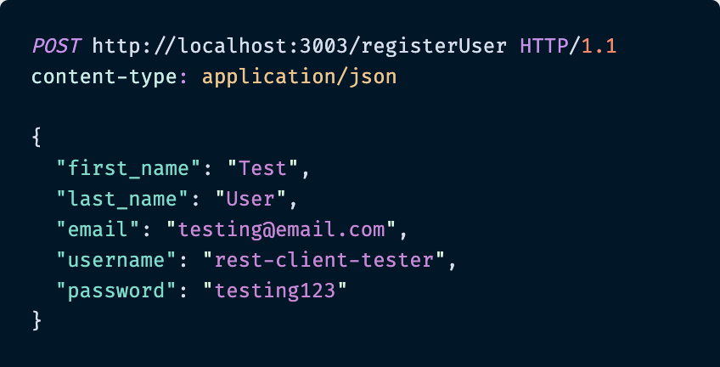
REST API example

Slide 30
REST and SOAP Similarities
Connect two applications via server-side data
Machine and human-readable
Use HTTP protocols and methods
Both can understand XML web documentation
Can use XML in requests and responses

Slide 31
REST and SOAP Differences
SOAP | REST
Official standard based upon a protocol | No official standard – an architectural style
Message format: only XML | Message format: plain text, HTML, XML, JSON, YAML, etc.
Transfer protocol: HTTP, SMTP, UDP, TCP, etc. | Transfer protocol: HTTP only
Takes more resources and bandwidth | Takes fewer resources and bandwidth
API calls cannot be cached | API calls can be cached
Strict rules | Best practices, more fluid
Built around remote procedure calls (RPC) | Resource based
Poorer performance, more complexity, less flexibility | Less security, not suitable for distributed environments
High security, standardized, extensible | Scalability, better performance, browser-friendliness, flexibility

Slide 32
REST is most popular!
Uses standard HTTP requests
Preferred choice for public APIs and open-source work
Lighter architecture and allowance for JSON
Learning curve is less steep
Footprint is small
JSON parsing is less compute and memory intensive than XML
Scability
Flexibility & Portability
Independence

Slide 33

HTTPS
Secure APIs will use HTTPS
Certificate based TLS
All requests are encrypted
REST uses HTTP by default
Clear text is sent and received
Bad security posture

Slide 34

Authentication & Authorization
Secure web API from unauthorized users
Authentication
Authorization
Always use TLS (see previous slide)
OAuth2 (SSO)
OpenID Connect

Slide 35
Demo
Let’s try to put it all together…

